Slide 1



Hadoop Tutorial
MapReduce : InputSplit VS Block

Slide 2

Hadoop MapReduce: InputSplit VS Block
Block in HDFS
Block is a continuous location on the hard drive where data is stored in the HDFS.
Block is the actual physical data stored on the different DataNodes in HDFS.
HDFS stores each file as number of blocks,along with the replication.
The Hadoop application is responsible for distributing the data block across multiple nodes.

Slide 3

Hadoop MapReduce
InputSplit in Hadoop
InputSplit is the logical representation of data blocks which would be fed to individual mapper during MapReduce. Contains only the reference to the actual data blocks.
The data to be processed by an individual Mapper is represented by InputSplit.
The number of map tasks is equal to the number of InputSplits.
The split is divided into records by RecordReader and each record (which is a key-value pair) is processed by the map.
Initially, the data for MapReduce task is stored in input files and input files typically reside in HDFS.
InputFormat is used to define how these input files are split and read.It is responsible for creating InputSplit.

Slide 4

MapReduce InputSplit vs Blocks-
InputSplit vs Block Size in Hadoop:
Block – The default size of the HDFS block is 128 MB which we can configure as per our requirement through the property: dfs.block.size.
All blocks of the file are of the same size except the last block, which can be of same size or smaller.
The files are split into 128 MB blocks and then stored into HDFS.
InputSplit – By default, split size is approximately equal to block size.configured by the property : mapred.max.split.size
InputSplit is user defined and the user can control split size based on the size of data in MapReduce program.

Slide 5

Hadoop MapReduce
Data Representation in Hadoop Blocks vs InputSplit
Block – It is the physical representation of data. It contains a minimum amount of data that can be read or write.
InputSplit –
It is the logical representation of data present in the blocks.
It is used during data processing in MapReduce program.
InputSplit doesn’t contain actual data, but a reference to the data.

Slide 6

Hadoop MapReduce
Physical File at HDFS split into 2 Blocks
Block-1
128 MB
Block-2
12 MB
Physical File at HDFS split into 2 Blocks
SampleInputFile.txt
140 MB
InputSplit
Block-1
128 MB
Block-2
12 MB
Logical Grouping of blocks in InputSplit

Slide 7
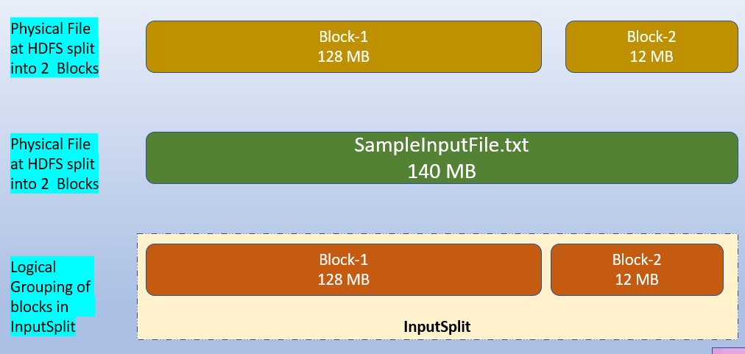

Hadoop MapReduce
Suppose we have a file of 140 MB, so HDFS will break this file into 2 blocks 128 and 12 mb each.
Now, if we want to perform MapReduce operation on the blocks(input file), it will not process, because the 2nd block is incomplete.
Thus, this problem is solved by InputSplit.
InputSplit will form a logical grouping of blocks as a single block.
Because the InputSplit include a location for the next block and the byte offset of the data needed to complete the block.

Slide 8

Conclusion:
InputSplit is only a logical chunk of data i.e. it has just the information about blocks address or location at the physical level HDFS.
During MapReduce execution, Hadoop scans through the blocks and create InputSplits.
Each inputSplit will be assigned to individual mappers for processing.
InputSplit does the liaisoning (act as a broker) between actual data block and mapper.

Slide 9
Thanks and do subscribe to my channel

